Slide 1
Module 4: Optical Detectors Basics of photodetectors
EXTC – BE – Optical Communication (ECC703)
Prof. Shyamala Mathi
Assistant Professor
Dept. of Electronics and Telecommunication,
SIES Graduate School of Technology

Slide 2
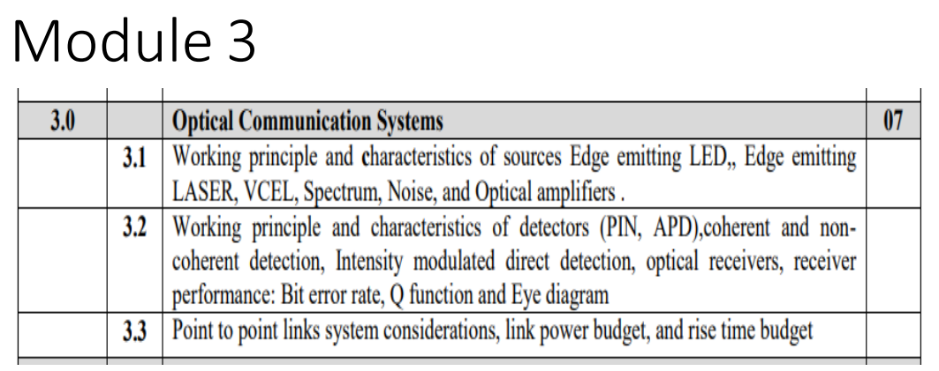

Slide 3
Optical detectors
The following criteria are the important performance and compatibility requirements for detectors:
High sensitivity at the operating wavelengths.
High fidelity.
Large electrical response to the received optical signal.
Short response time to obtain a suitable bandwidth.
A minimum noise introduced by the detector.
Stability of performance characteristics.
Small size.
Low cost and Long operating life.

Slide 4
Device types
To detect optical radiation, both Internal and External photoemission of electrons may be utilized. Hence,
External Photoemissive devices
Internal Photoemissive devices
Photomultiplier tubes and vacuum photodiodes are external photoemission devices which meet some of the performance criteria but they are too bulky, and require high voltages for operation.
Internal photoemission devices, especially semiconductor photodiodes with or without internal (avalanche) gain, provide good performance and compatibility with relatively low cost.
Semiconductors such as silicon, germanium and III–V alloys (eg- GaAs)
Group III | Group V
B | N
Al | P
Ga | As
In | Sb

Slide 5
Optical detection principles

Slide 6



Slide 7

Optical Absorption Coefficient:

Slide 8
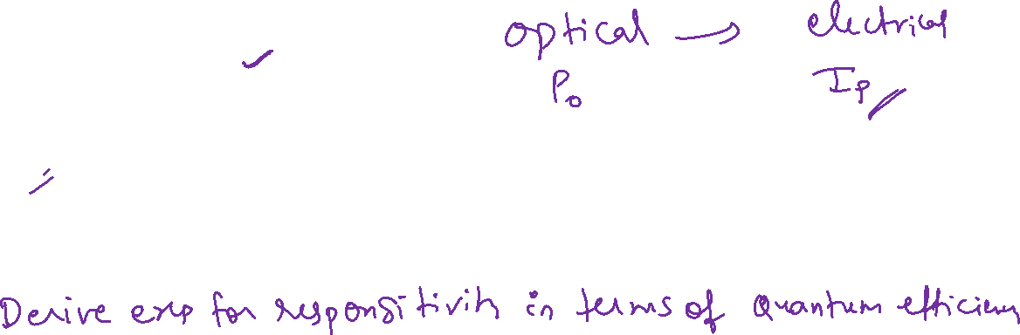
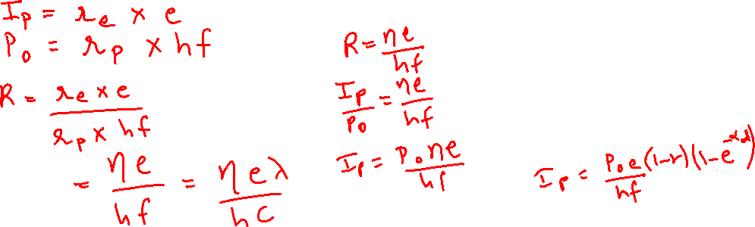

Slide 9
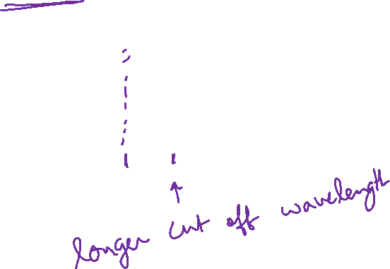

Slide 10
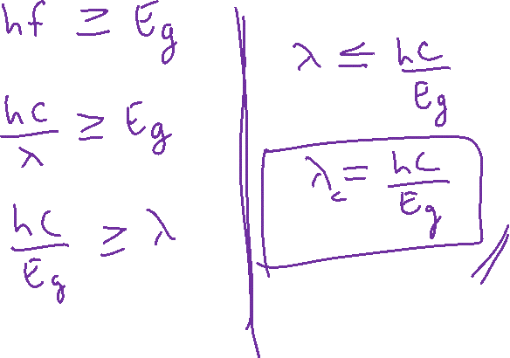

Slide 11
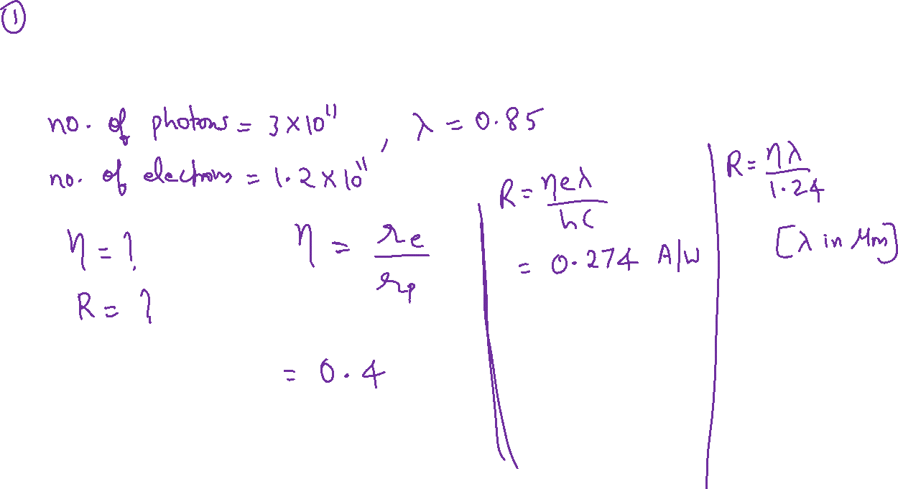

Slide 12
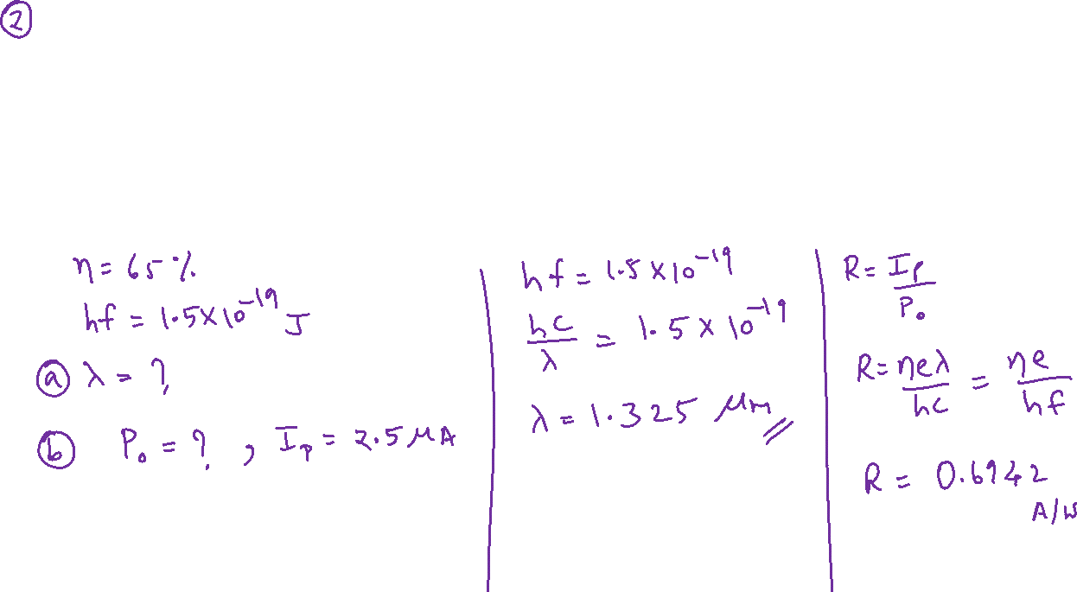

Slide 13
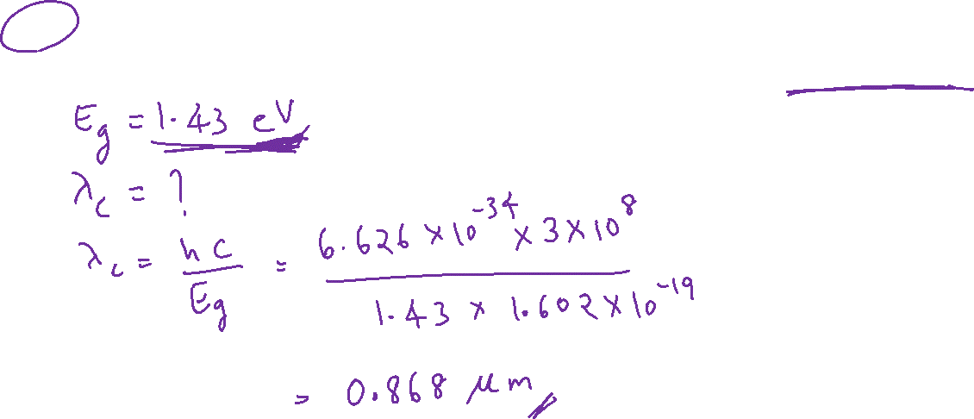

Slide 19












Slide 20
For minimum noise,
the electric field at avalanche breakdown must be as low as possible
and the impact ionization should be initiated by electrons.
To this end a ‘reach through’ structure has been implemented with the silicon APD.

Slide 22
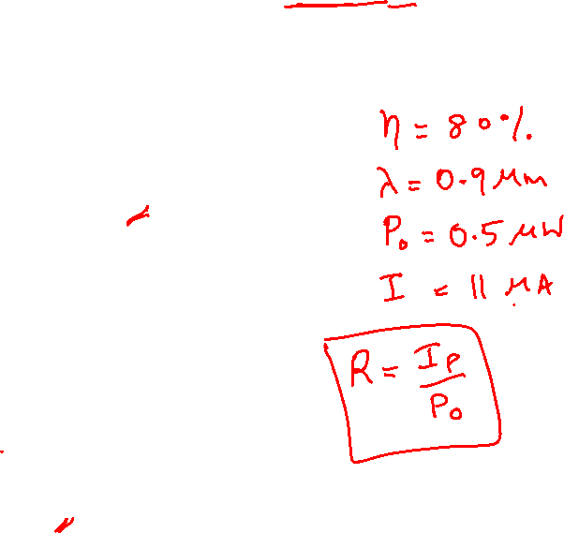

Slide 23
There is tradeoff between quantum efficiency (sensitivity) and speed of operation. pn photodiode – drift and diffusion process reduces the speed of operation. pin photodiode – diffusion process is reduced here by increasing the width of depletion region. Avalanche photodiode – No diffusion process. Also has internal gain. Drift time is reduced by having less electric field in pi-region.

Slide 25
Noise in photodetectors:
Noise is a term generally used to refer to any spurious or undesired disturbances that mask the received signal in a communication system.
In copper wired communication – electromagnetic interference
In Optical Communication – spontaneous fluctuations
They are –
Thermal Noise
Dark Current Noise
Quantum Noise

Slide 26
- Due to thermal interaction between free electrons and the vibrating ions in a conducting medium

Slide 27
When there is no optical power incident on the photodetector a small reverse leakage current still flows from the device terminals.
This dark current contributes to the total system noise and gives random fluctuations about the average particle flow of the photocurrent.

Slide 28
The photons incident on the photodiode does not have the same arrival rate. There are random fluctuations in the arrival rate. This causes the random fluctuation in the electrical signal. The noise current produced due to these fluctuations is called as photon (quantum) noise current.

Slide 30
Important Points:
The noise related to amplifier can be reduced with low values of detector and amplifier capacitance.
The thermal noise can be reduced by increasing the value of load resistor RL. But reduction of RL tends to reduce B.W of the receiver.

Slide 31
Thank You!
(shyamalae@sies.edu.in)

